Slide 1
R-Electroencephalography test: Reviewing and understanding the EEG waves
Dr. Selina H. Banu
Clinical Neurophysiologist
Course director, BCNEPS
Professor Pediatric Neurology
Dr. M.R.Khan Shishu Hospital and ICH
28th March 2022

Slide 2
Glossary of EEG
The most commonly used terms in the Cl.NP, with the specific criteria, necessary to describe the EEG and to generate the EEG report
In pediatric age group specific attention
age of appearance and normal variation with age and state.
That should be according to the previously well accepted EEG data
Each EEG phenomena: Must be precisely described, that should include
Morphology, frequency, amplitude, phase relation, waveform, localization, quality, variability and reactivity of these parameters (Brazier et al 1961)
Description should be independent of the recording parameters such as amplification, montages, and computer program/display.
Biological and technical artifacts should be eliminated or, be noted in description.
Terms should be Well established, proven in common neurological & clinical practice,

Slide 3
Important note on Recording Technique
Who? How? When?
Technician vs neurophysiologist/ physician
A cl neurophysiologists should be a technician at the beginning
Child vs adult: modification needed
Equipment setting: child vs adult
Infant, limited cooperation, multiple disability
Flexible approach expected
Feeding time, play, awake, sleep, drowsy
Clinical condition and clinical question
Greater variety of clinical problems in infant & children
Maturational age of the EEG activities

Slide 4
Common Questions before EEG advice
What about AED before the test?
In case acute attack
Chronic cases
what are the effect of drugs on EEG?
What about hair
Use of sedative
When to advise for Sleep deprivation?

Slide 5
EEG report description
Internationally acceptable standard protocol,
Description based on the knowledge of
Norms, variation with age, sex and state, deviation from norms,
activities in rest, reactivity to stimuli & to the reactivation procedure,
specific pattern etc. that needs exposure and experience
Interpretation:
Needs knowledge of the patient’s age
Clinical condition and state during recording
Level of consciousness/ vigilance and ability to cooperate
Previous record, clinical history
Finally, interpretation summarizes the whole description, clinical state, age, correlate with clinical problems, seizure/events, history, and gives a conclusive suggestion of electro-clinical diagnosis in the light of the cl question

Slide 6
How to proceed?
Sit with a piece of paper, pen/pencil, measuring scale
Know only the age and sex of the patient
Review the whole record using different montages
average, transvers, longitudinal (double banana), Multiphotic, common referential
What do you see? Morphology, distribution etc
Any noticeable outstanding pattern?
How it appears and disappears, duration, transient/in runs/as bursts
Reactivity to EC, PS, HV, Sleep/Drowsy, reactivity to noise
What else?
Background activity average those of frontal central and posterior activity
Describe morphology, Symmetry/ asymmetry

Slide 7
EEG reviewing:
Background activity
Reactivity to eye closure
Effect on PS
Hyperventilation
Drowsy state
Sleep stages:
Early sleep stage/ drowsy state
Stages 1st, 2nd, 3rd, 4th
REM sleep
On awakening
Arousal phenomena

Slide 8
WHAT TO LOOK FOR IN EEG RECORD?
Background ACTIVITY (spontaneous and reactivity to stimuli)
Symmetry: IN voltage / amplitude, IN frequency/ Hz / ___ c/sec
Mild asymmetry
Marked asymmetry
Reactivity
to eye closure
Photic stimulation
Hyperventilation
Activities in Drowsy state
Sleep state
Discharges of spike, polyspikes, sharp waves/transients, polyspike-wave complexes
Describe the appearance of discharges
Transient (focal, multifocal, bursts) /paroxysms/ persistent/ runs
Repeated, periodic, Persistent
Synchrony / asynchrony
Localization,

Slide 9
Bursts:
Stretches of attenuation, periods of attenuation, Suppression :
Discontinuous
Continuous

Slide 10
What are the four basic EEG rhythms?
There are four basic EEG frequency patterns as follows:
The amplitude of EEG increases as the frequency decreases.
Each of the four EEG frequencies is associated with a different level of arousal of the cerebral cortex
EEG activity is divided into 4 frequency band
Delta: slow activity <4 c/s
Theta: 4-<8c/s
Alpha: 8-13 c/s
Beta: >13 c/s

Slide 11
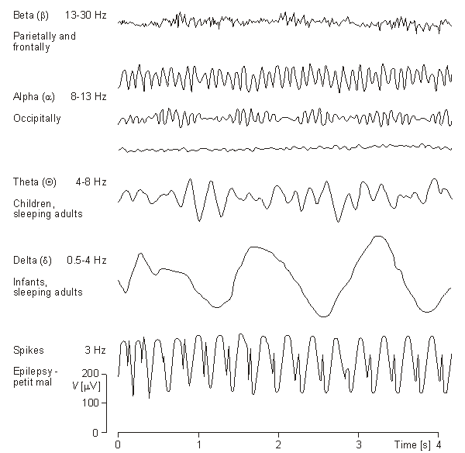
EEG Rhythms

Slide 12
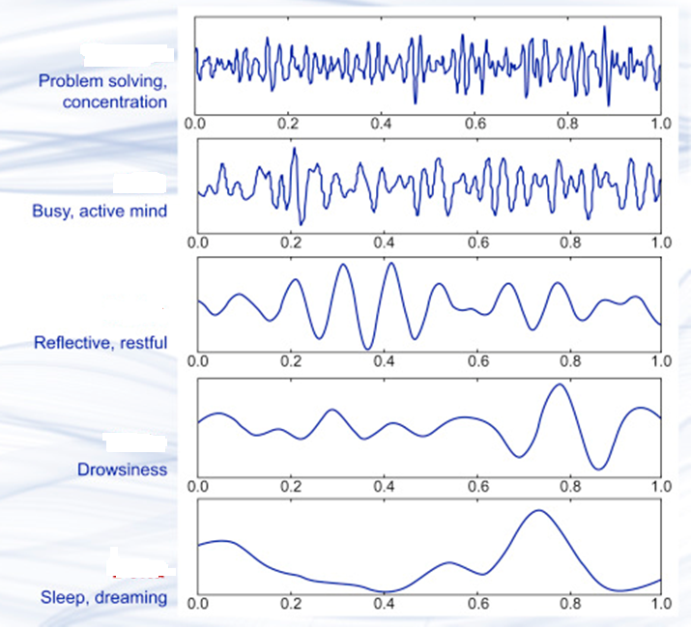
Question for you

Slide 13
Background activity
One of the initial goals for EEG interpretation is determination of the background activities. To gain a complete sense about the background EEG, one should employ a variety of different screening montages to enable several different perspectives of its
chief frequencies,
amplitude, and
degree of synchrony.

Slide 14
Frequently used terms (Chatrian et al 1983)
EEG Montage: Montages are logical, orderly arrangements of EEG channels, created to
display activity over the head & to
provide lateralizing and localizing information.
Two primary types of display montages:
bipolar (Tr, Long,
monopolar/referential.
Common average and Laplacian montages helpful in some situations.
Each type of montage has certain strengths and limitations,
ACNS guidelines :
must use multiple montages for each EEG record
Use standard montage
additional montages can be designed using the electrodes within the 10-20 system or by placing additional electrodes.

Slide 15
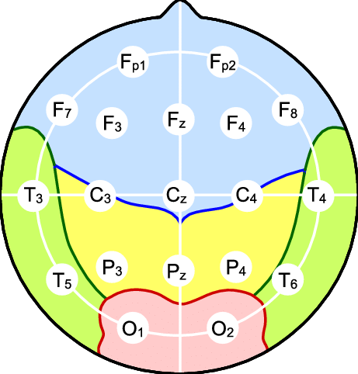
Montage we use

Slide 17
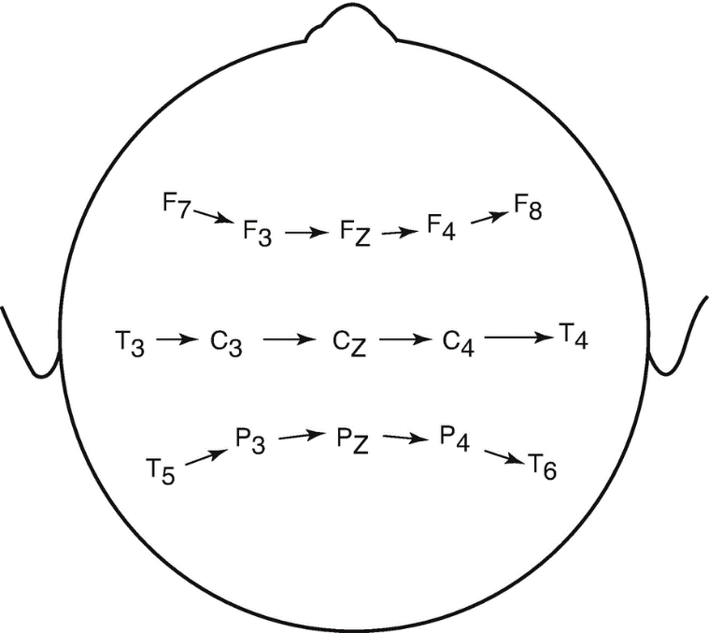
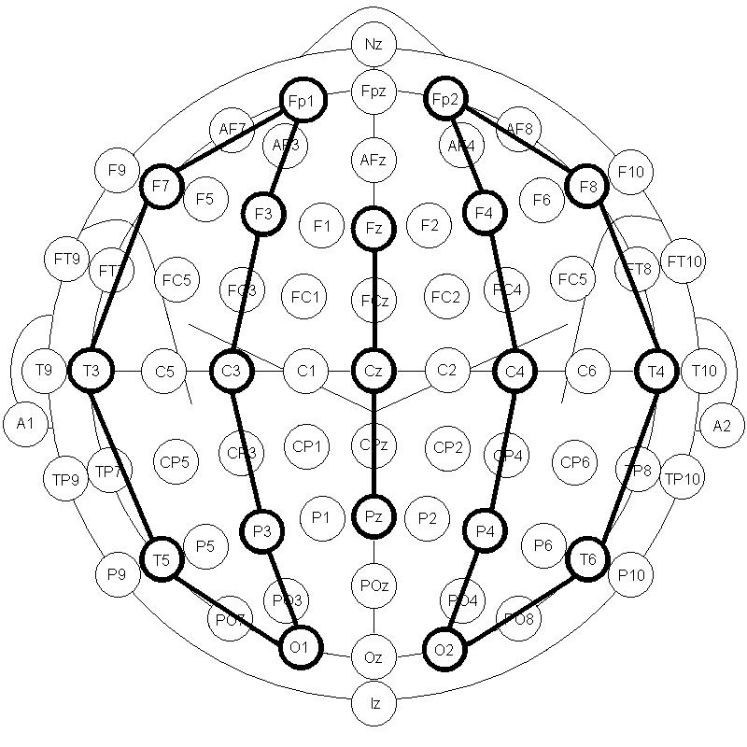
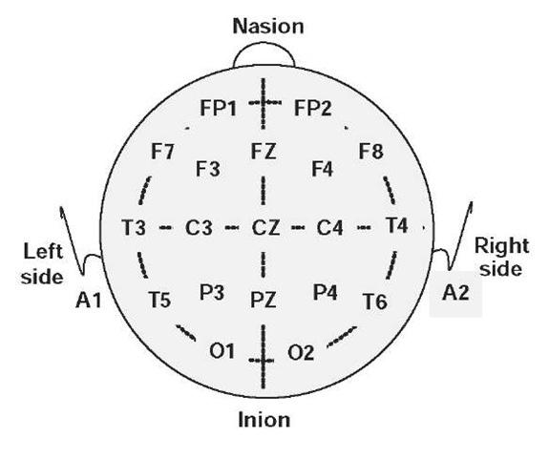
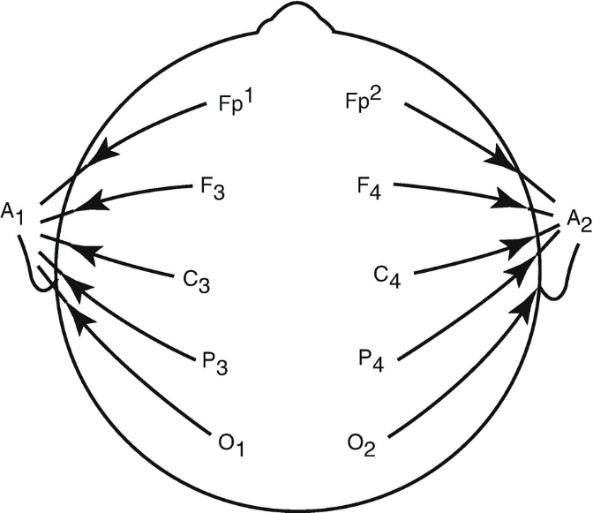

Slide 18
Lance-Adams syndrome?
Symptoms such as action myoclonus are accompanied by cerebellar ataxia and appear days or weeks after the event.
What causes LA Syndrome?
is a rarely occurs after successful cardiopulmonary resuscitation and is likely caused by hypoxic changes.

Slide 19
Polygraphy:
EEG, Surface EMG, EKG (characterized motor manifestations during MC sz/ absences/ atonic etc)
Polysomnography
Amplitude:
Rhythmic
Frequency: number of repetitive waves in 1s, sometimes expressed in Hz, but cycle /second is appropriate as EEG activities are note strictly since waves

Slide 20
Polygraphy ?

Slide 21
Polygraph tracing in REM sleep

Slide 22
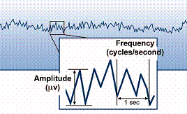
Amplitude and frequency

Slide 23
Frequently used terms-2 (Chatrian et al 1983)
Mu rhythm: normal activity of vigilance, central/ parietal region in wake and alert state. Comb like appearance or arch shaped. It may be blocked by contralateral limb movement.
Lambda waves: normal transients seen over occipital areas during visual exploration. Usually triangular in shape and surface positive
Background activity: Ongoing activity not including specific rhythms, representing the setting in which a given normal or abnormal pattern appears.
Vertex sharp transients : Normal sharp transient noted over the Cz, Fz area usually seen in early stage of sleep. Appears at age?
Sleep spindle: Rhythmic bursts/ runs of rhythmic activity 12-14 c/s usually most obvious over the cenetral region during sleep stage II, appeas at 2-3 mo age
K-Complexes: Large amplitude, usually biphasic slow waves , frequently associated with a sleep spindle, and most obvious around the vertex. This occurs in sleep either spontaneously or in response to stimulus. 1st appears at 4 month of age.

Slide 24
Frequently used terms-3 (Chatrian et al 1983)
Spike-sharp waves: Clearly distinguishable transients, usually surfave negative. A spike is defined as shorter duration <70 ms, than a sharp wave (70-200msc ). Polyspikes are multiple spikes-grouped together.
Complexes: A sequence of two or more waves recurring with similar relationship to each other, e.g., spike-wave complexes.
Discharge: an interpretative term, usually refers to sharp wave waves with or without associated slow waves. The term implies a possible association with epilepsy. Epileptiform activity has similar connotations.
Dysrhythmia is a non-specific term which has been used to escribe such a wide range of EEG feature, including epileptiform activity that it is best avoided.
Paroxysms: are clearly defined episodes with abrupt onset and termination. The term may be misleading if only slow activities are present and in this tedt it is only used when the episode contains spike/sharp waves and can therefore be regarded as epileptiform.
Electrocerebral inactivity (electrocerbral silance or isoelectric EEG) : is absence of identifiable electrical activity of cerebral origin. The term flat EG is nota synonym as it is often used loosely to describe low voltage activity, which may even be normal.
Burst suppression: is a pattern characterized by burst of theta and/ or delta waves, sometimes mixed with faster components, separated by periods of relatively quiescence. The term is widely misused and should be restricted to describe the EEG at certain level of anesthesia. It should note be confused with “trace alternance” which is seen in quiet sleep state of neonate.

Slide 25
Mu Rhythm

Slide 29
Photic stimulation

Slide 30
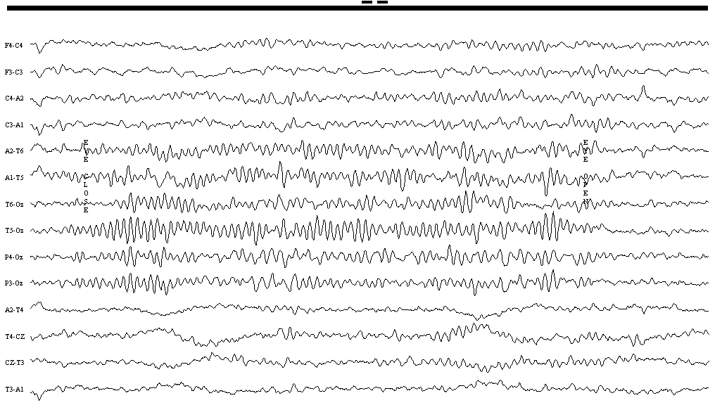

Slide 31
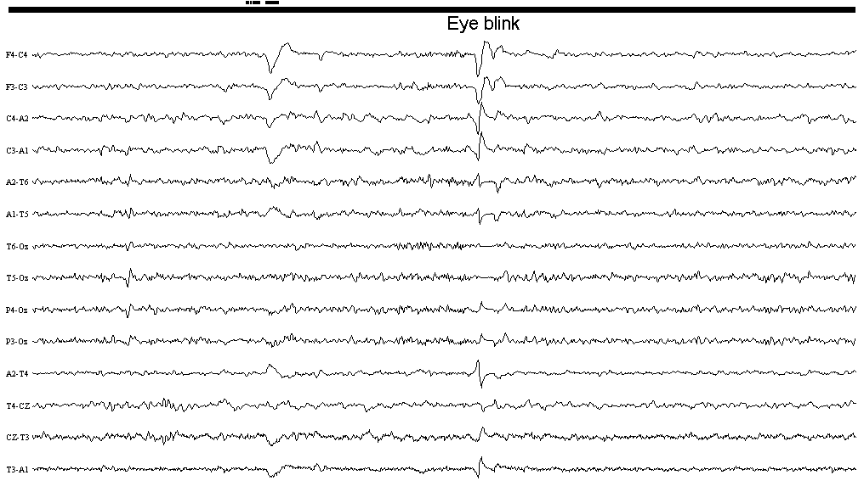

Slide 32
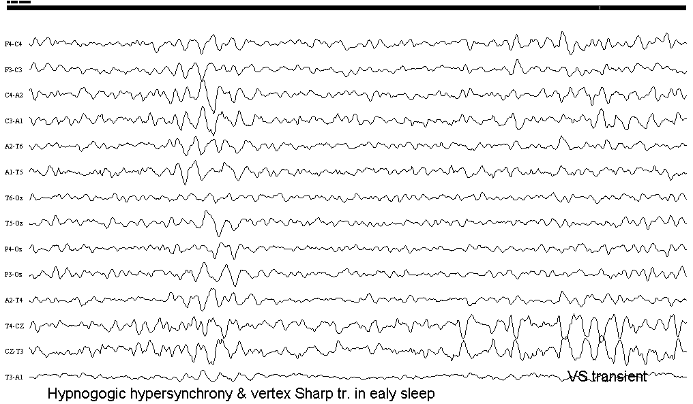

Slide 33
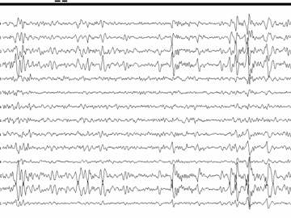
Vertex sharp transients/K complexes: normal sleep stage 1 and 2 (drowsy and early sleep), mistaken for epileptiform discharges

Slide 34
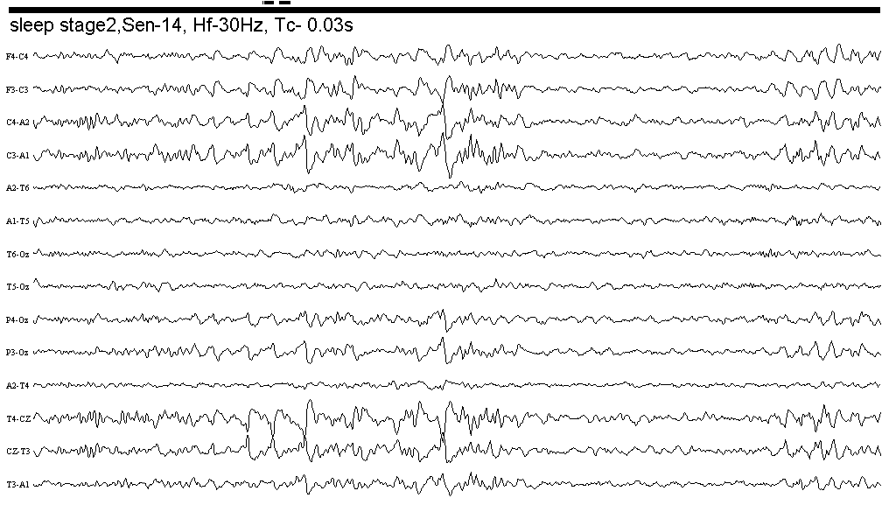

Slide 35
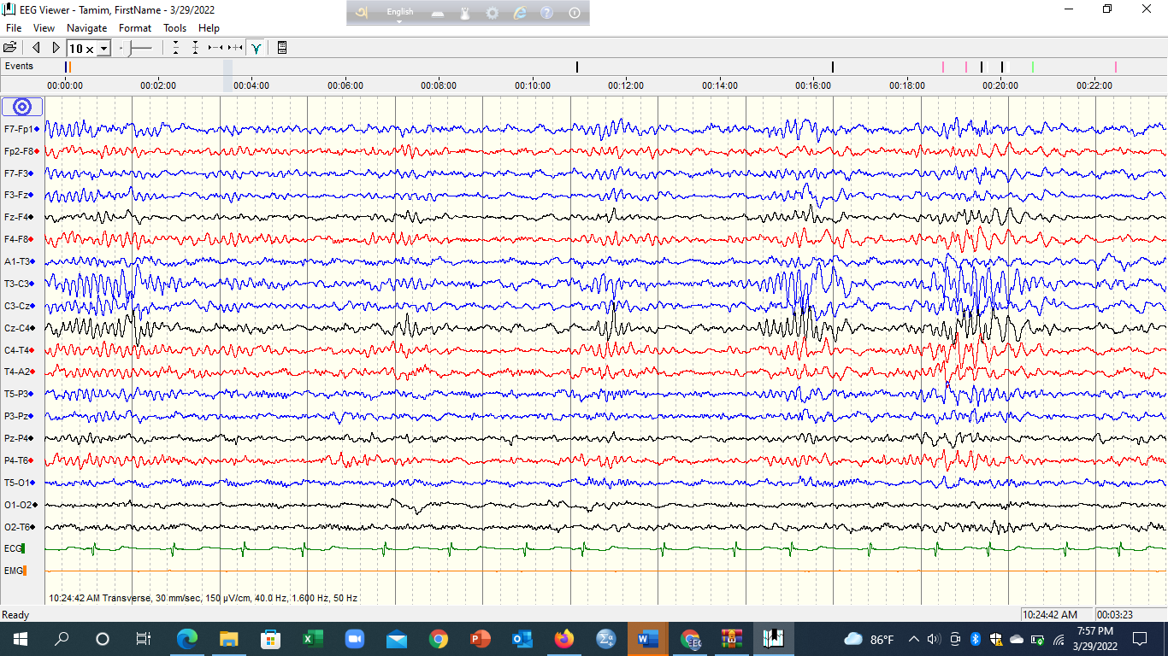

Slide 36
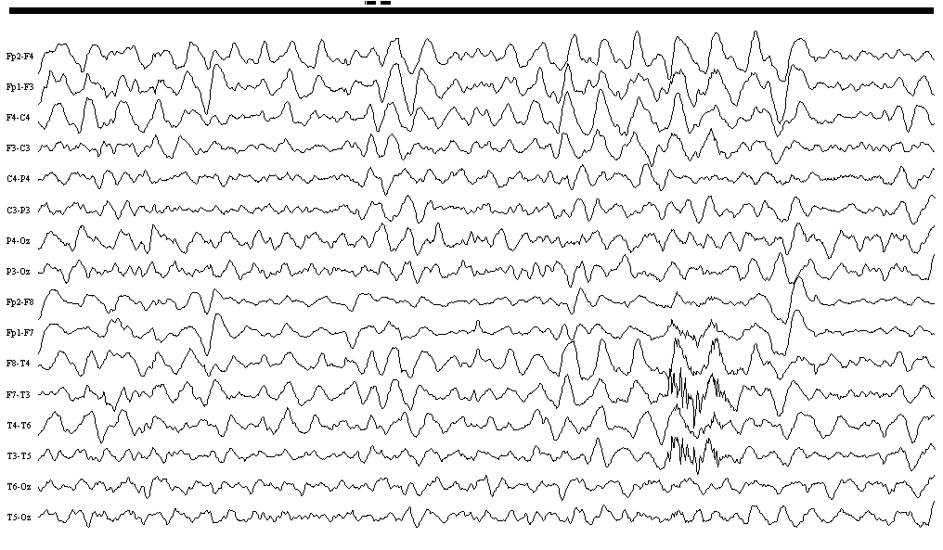

Slide 37
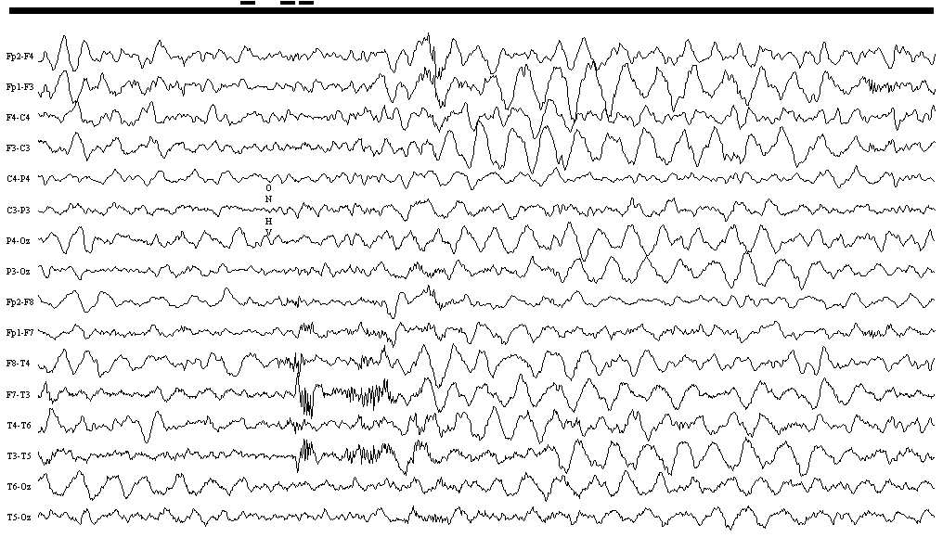

Slide 38
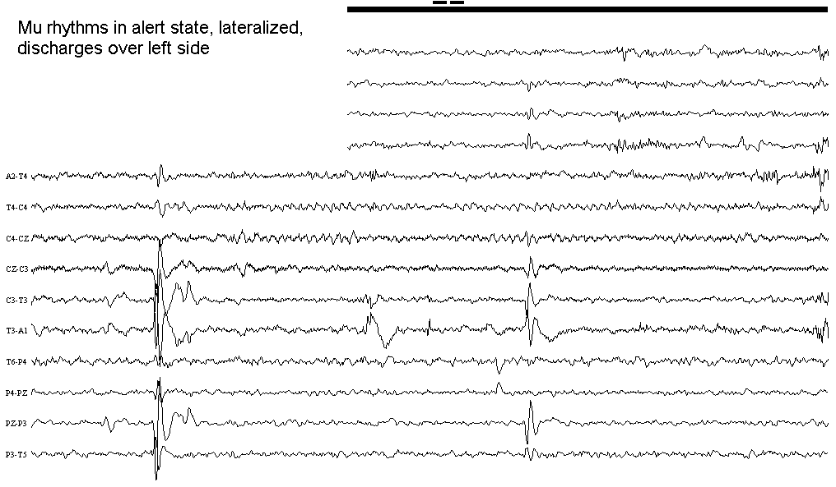

Slide 39
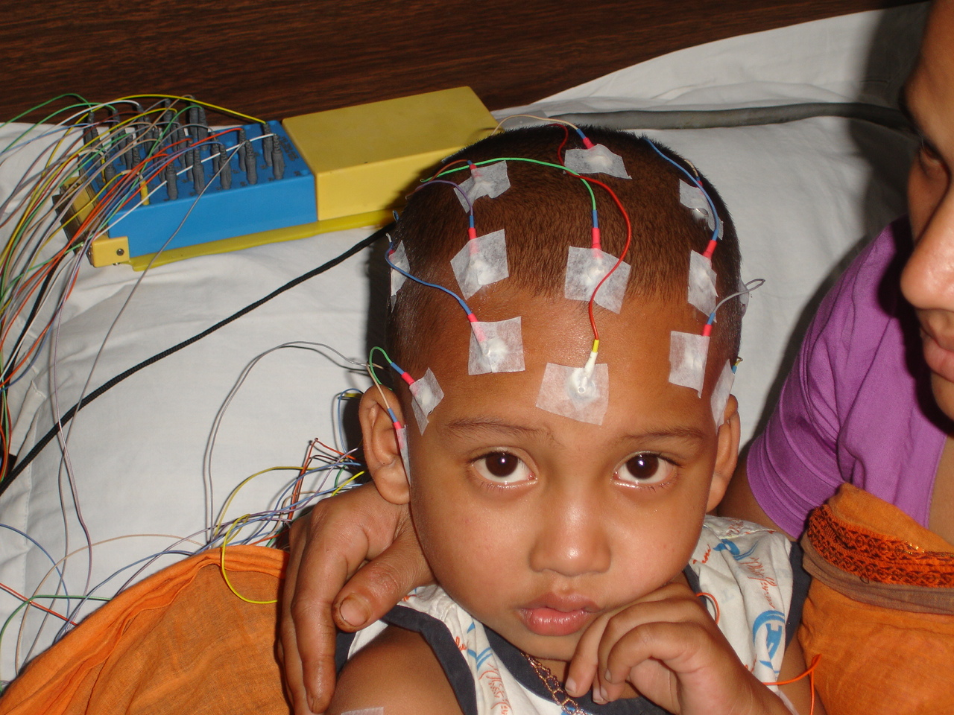

Slide 40
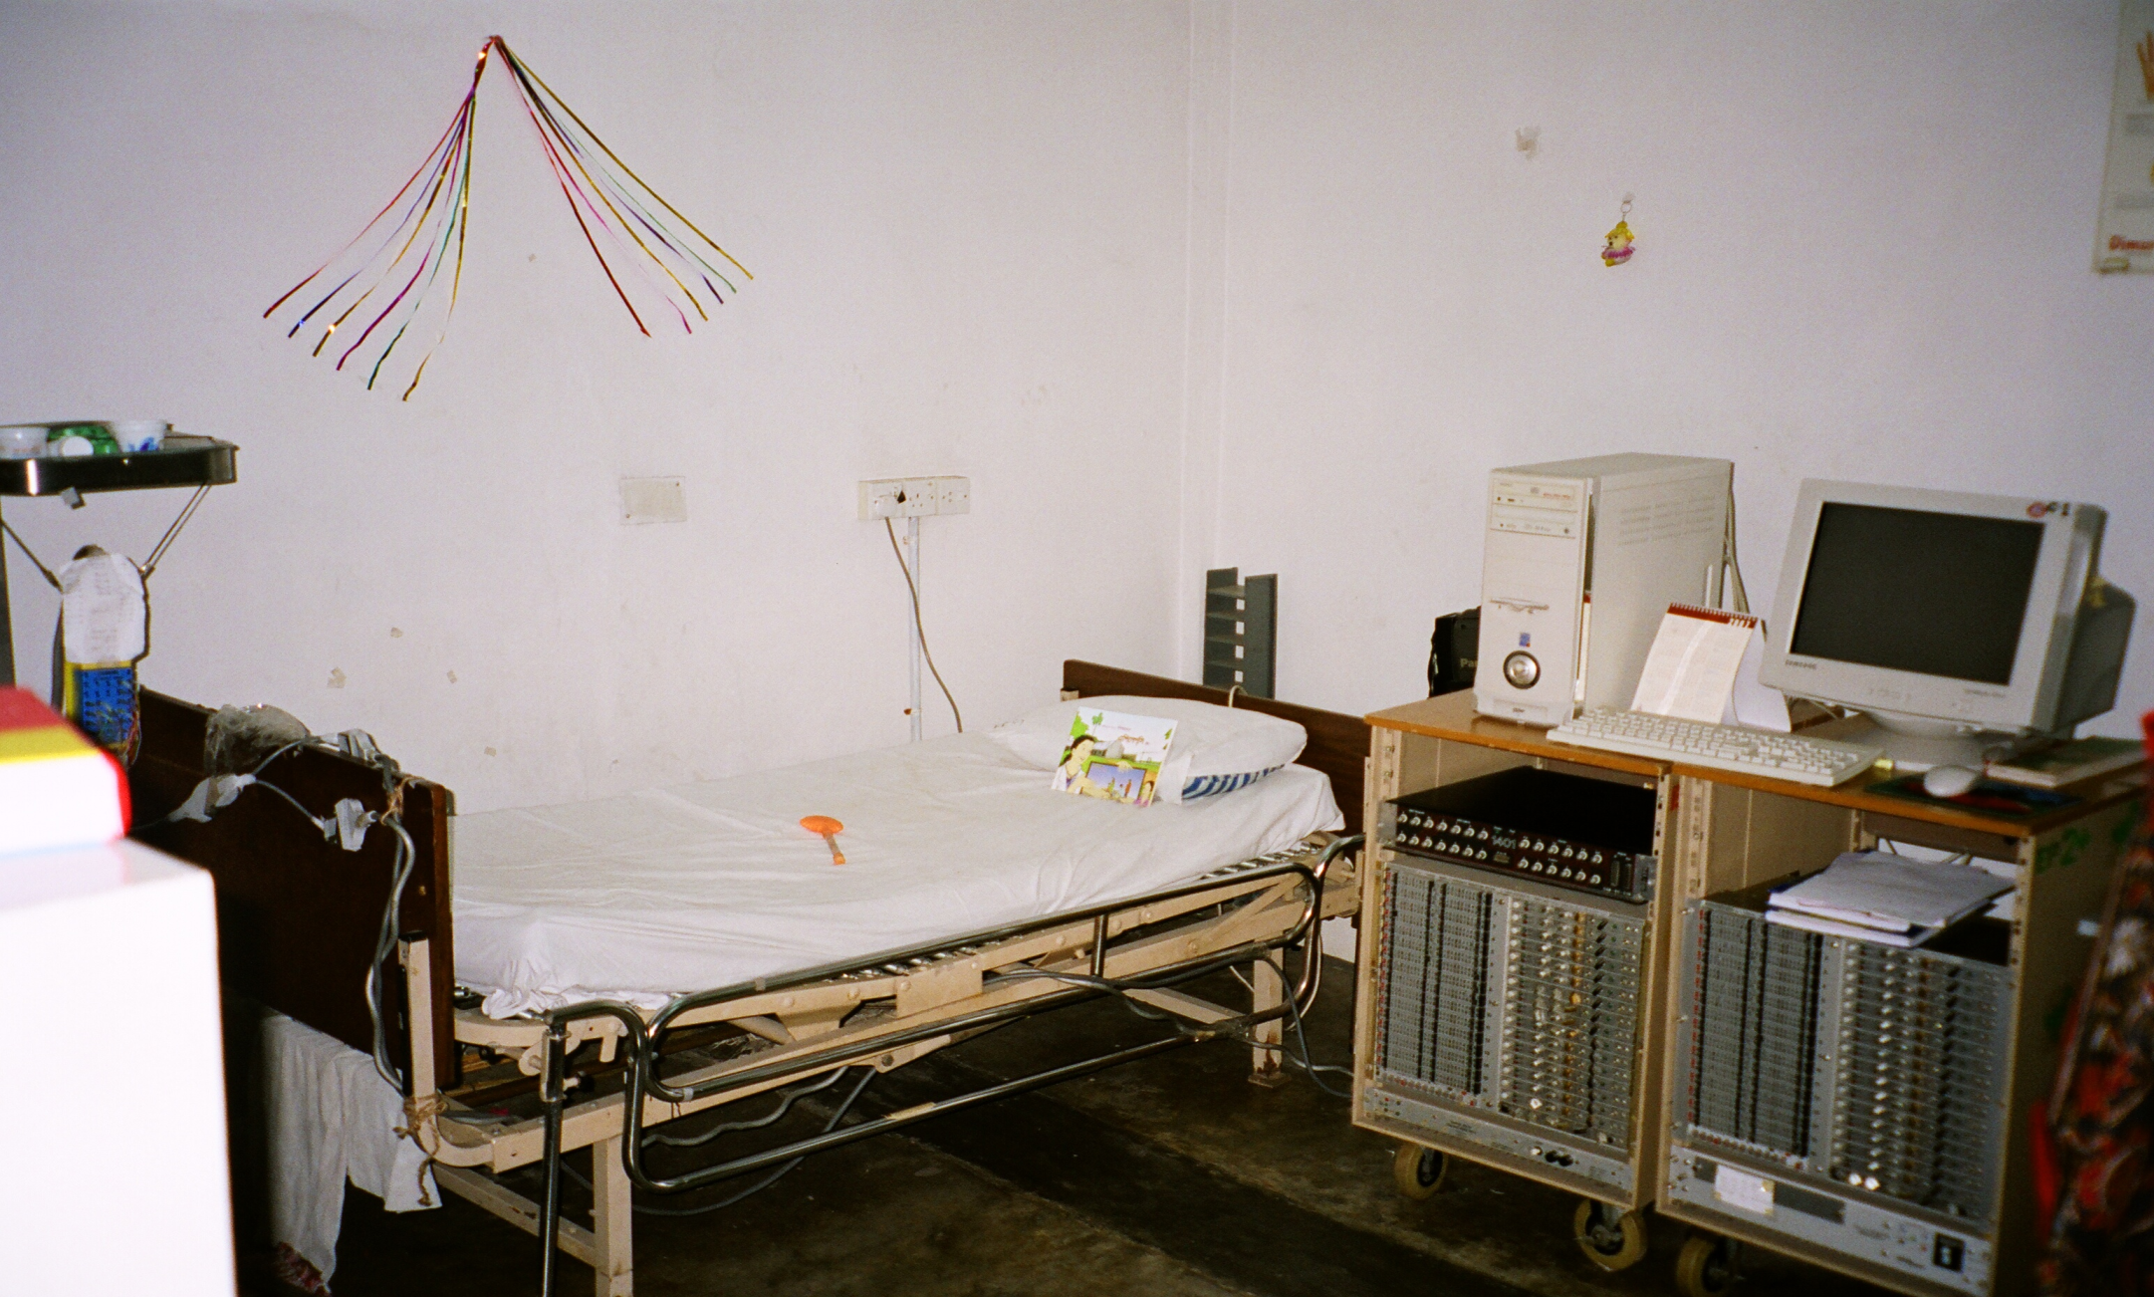
Digital 1st EEG machine at DSH, donated b, department of ClNP, GOSH, ICH London

